Slide 1
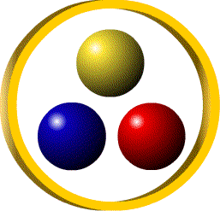
EURASIA – MENA Mining,
Industrial Minerals and Mineable Energy
Trade&Investment Summit
16-17 May 2012 Istanbul, Turkey
ETİ MADEN
‘‘World Leader in Boron Sector’’
ETİ MADEN-BORON SECTOR
THORIUM AND RARE EARTH ELEMENTS
Orhan YILMAZ, PhD
Chairman and General Manager

Slide 2
Eti Mine in Figures; Production & Capacity

Slide 3
Eti Mine in Figures; Sales

Slide 5
ETİ MADEN REGIONAL BORON EXPORT (Far East, Europe, USA)
Europe
USA

Slide 6
FAR EAST-CHINA EXPORT (Ton)
Japan
Korea
Taiwan
China

Slide 7
Consumption of Boron Products in the World & Change in the Eti Mine’s Market Share
Consumption of Boron Products in the World (Million Tons)
2000
3.1
2.7
2005
3.3
World Boron Leader
2010
2011
4.0
4.3
2002
Change in the Eti Mine’s Market Share
2000
29 %
2002
29 %
2005
36 % World Boron Leader
2011
42 % World Boron Leader
47 %
World Boron Leader
2010

Slide 8
Boron Minerals Produced By Us; Colemanit, Tincal and Ulexite
Following four minerals
comprise around 90 % of
commercially use.
Colemanite (Ca₂B₆O₁₁.5H₂O)
Tincal (Na₂B₄O₇.10H₂O)
Ulexite (NaCaB₅O₉.8H₂O)
Kernite (Na₂B₄O₇.4H₂O)
Colemanite and tincal are the most widely-used boron minerals.
Turkey is the world’s major source of colemanite.

Slide 9
BORON IN USE
CONCENTRATED BORON PRODUCTS
Colemanite, tincal and ulexite etc. concentrated ores
BORON CHEMICALS
Borax pentahydrate, borax decahydrate, anhydrous borax, boric acid, sodium perborate monohydrate, anhydrous boric acid and etc.
SPECIALITY BORON PRODUCTS
Boron carbide, zinc borate, boron nitride, boron hydride, ferrobor & other boron compounds.
INDUSTRIES DEPENDING ON BORON
Insulation and textile grade fiberglass,borosilicate glass, ceramic, detergent etc.
GLASS
DETERGENT
AGRICULTURE
CERAMIC
OTHER

Slide 10
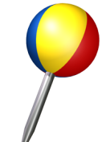
World Boron Mineral Reserves
RUSSIA
8%
USA
7 %
KAZAKHSTAN
1%
CHINA
4%
TURKEY
% 72
PERU
2%
BOLIVIA
2%
CHILE
3 %
ARGENTINA
1%

Slide 11
World Boron Consumption by End-Use in 2011
Consumption of borates in fiberglass is concentrated in China, the world’s largest producer of textile-grade material, and in the USA, the world’s largest producer of insulation-grade material.

Slide 12
Boron Products & Production Sites of Eti Maden
BANDIRMA BORON WORKS
Borax Decahydrate
Borax Pentahydrate
Boric Acid
Boron Oxide
Etidot-67 (Agri Boron)
Sodium Perborate
KIRKA
BORON WORKS
Etibor-48 (Borax Pentahydrate)
Etibor-68 (Anhydrous borax)
Calcined Tincal (Compacted)
BİGADİÇ
BORON WORKS
Ground Colemanite / Ulexite
Natural Zeolite
EMET
BORON WORKS
Concentrated Colemanite / Tincal / Ulexite
Concentrated Colemanite
Boric Acid

Slide 13
Boron Products Export of Eti Maden, 2011 (Regional & Sectoral Distribution, Quantity Based)
The regional distribution’s percentage of boron products export follows a fluctuating course.

Slide 14
Market Shares, 2011
Russia
China
South America
Quantity based

Slide 15
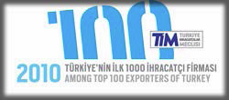
Eti Maden in Turkish Economy
Eti Mine is stated as 1st in public rank and 16st in general rank in the list of “Top 1000 Exporters of Turkey*”
*TEA (Turkish Exporters Assembly)

Slide 16
Eti Maden in Turkish Economy
Eti Maden rose to 43rd in rank of general evaluation from the level of 56th in 2009 and placed in 6th as gross profit rank in the list of “500 Large Enterprises*” in 2010.
Export
829 million US$
Gross Profit
488 million US$
Dividend paid to treasury
300 million US$
Sales Revenue 854 million US$
2011
*ISO (Istanbul Chamber of Industry)

Slide 17
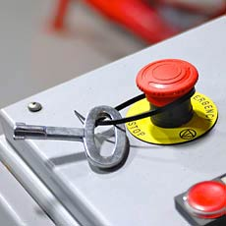
INVESTMENT POLICY AND METHODOLOGY
PURCHASING POLICY
OUR STRATEGY
INVESTMENT METHOD
to provide exchange savings by purchasing machinery and equipment from local manufacturers
To enlarge scale of investments with new and modern technology for the opportunities of the market
To implement as a turn key process covering know-how, engineering, construction and commissioning of the plant.

Slide 18
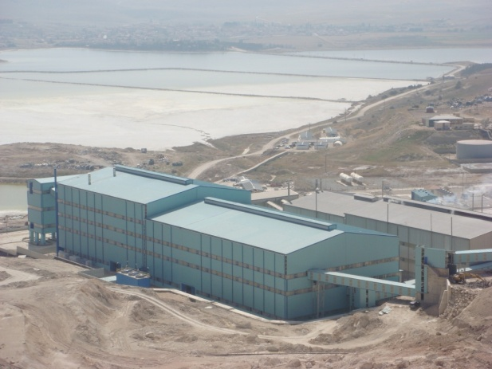
COMPLETED INVESTMENTS (2002-2007)
2002
THIRD BORAX PENTAHYDRATE PLANT, KIRKA, ESKİŞEHİR (2002)
2003
SULFURIC ACID PLANT, BANDIRMA, BALIKESİR
2004
SECOND GRINDING PLANT, BİGADİÇ, BALIKESİR
2005
BORIC ACID PLANT, EMET, KÜTAHYA
2007
SODIUM PERBORATE PLANT (EXPANSION), BANDIRMA, BALIKESİR
CONCENTRATOR PLANT (EXPANSION), BİGADİÇ, BALIKESİR
BORON OXIDE PLANT (SECOND LINE), BANDIRMA, BALIKESİR
CALCINED TINCAL PLANT, KIRKA, ESKİŞEHİR
Capacity
240.000 t/y
III.BORAX PENTAHYDRATE PLANT,
KIRKA, ESKİŞEHİR

Slide 19
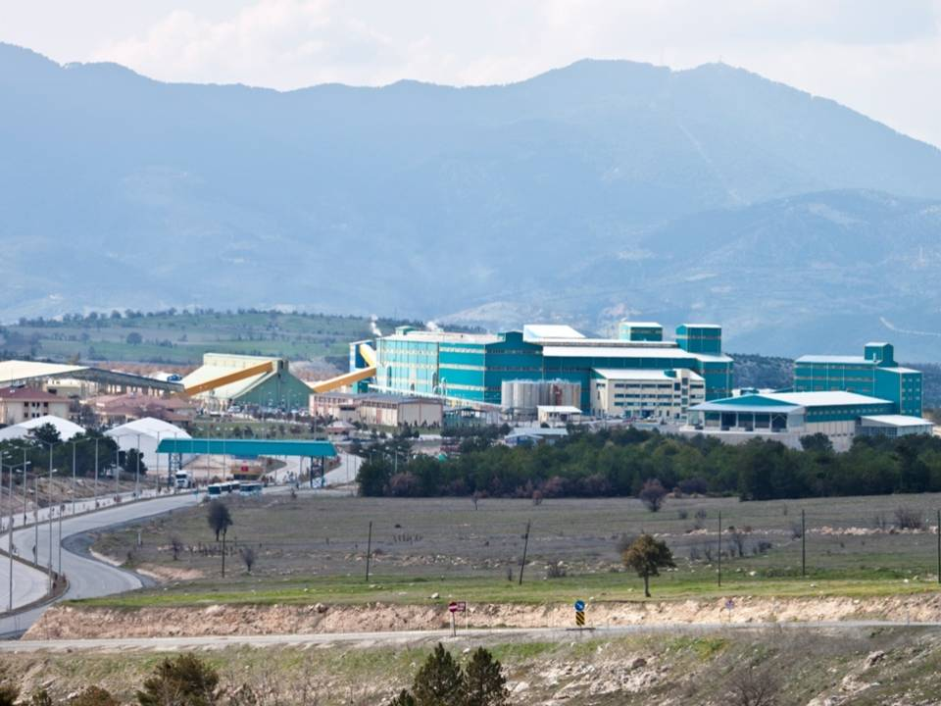
COMPLETED INVESTMENTS (2008-2011)
2008
BORAX DECAHYDRATE PLANT (EXPANSION), BANDIRMA, BALIKESİR
ANHYDROUS BORAX PLANT, KIRKA, ESKİŞEHİR
2009
BORAX DECAHYDRATE PLANT, KIRKA, ESKİŞEHİR
AGRI-BORON (ETİDOT-67), BANDIRMA, BALIKESİR
2010
REHABILITATION OF STOCK AREAS, BİGADİÇ, BALIKESİR
CAMKOY WASTE RESERVOIR CAPACITY INCREASE, BİGADİÇ, BALIKESİR
NEW STEAM BOILER UNIT, BANDIRMA, BALIKESİR
SINGLE PHASE PENTA PRODUCTION PLAN, KIRKA, ESKİŞEHİR
AGILDERE WASTE RESERVOIR ELEVATION, EMET, KÜTAHYA
2011
FOURTH BORAX PENTAHYDRATE PLANT, KIRKA, ESKİŞEHİR
BORIC ACID PLANT (EXPANSION), EMET, KÜTAHYA
CONCENTRATOR & GRINDING PLANT, BİGADİÇ, BALIKESİR
Capacity
120.000 t/y
II. BORIC ACID PLANT,
EMET, KÜTAHYA

Slide 20
Targets of Strategic Plan
Long Term Targets
2013
2023
PRODUCTION CAPACITY OF BORON CHEMICALS
2.1 MILLION TONS
PRODUCTION CAPACITY OF BORON CHEMICALS
5.5 MILLION TONS
Notes:
20
20

Slide 21
Possible Investment Opportunities
Glass Industry
Fiberglass (Reinforcement-Textile Fiberglass)
Glass Wool (Insulation Fiberglass)
Borosilicate Glass
Specialty Boron Products
The primary specialty boron products are boron carbide, boron nitride etc.

Slide 22
Employment

Slide 23
NEW EMPLOYMENT
PAST TEN YEARS AND COMING TEN YEARS
INVESTMENT COST FOR THE NEW CAPACITIES IN 10 YEARS PERIOD
508,7 MILLION US$
NUMBER OF EMPLOYMENT
FOR THE NEW INVESTMENTS
1.213 PERSON
TARGETED ADDITIONAL CAPACITY UP TO 2023
3,8 MILLION TON
ESTIMATED EMPLOYMENT FOR THE ADDITIONAL CAPACITY
2.500 PERSON

Slide 24
ELECTRICITY PROFILE
CONSUMPTION AND PRODUCTION ( 2011)
The ratio of production and consumption
91.7 %
GENERATED
ELECTRICITY
255,309,063 kWh
CONSUMED ELECTRICITY
278,387,448 kWh
SOLD ELECTRICITY TO NATIONAL GRID (TEİAŞ)
13,995,843 kWh
PURCHASED ELECTRICITY FROM TEİAŞ
37,074,228 kWh
INSTALLED POWER
51.36 MWh
TEİAŞ: Turkish Electricity Transmission Co.

Slide 25
RARE EARTH ELEMENTS AND THORIUM RESERVE
Eti Maden posesses the operating license of rare earth elements and thorium reserve located in Eskişehir/Sivrihisar region. The ore is complex in nature.
The ore contains REE (Rare Earth Elements) Cerium, Lantan, Neodium, barite and fluorite besides thorium.
Mineral contents of the orebody; 37,44% CaF2, 31,04% BaSO4 and 3,14% RRE. Calculated total reserve is about 30.358.268 ton.
Amount of those minerals in the orebody: 11.366.135 ton Fluorite, 9.424.424 ton Barite, 953.587 ton RRE (CeO2+La2O3+Nd2O3), 8.612.182 ton gang minerals.

Slide 26
RARE EARTH ELEMENTS PROJECT
Feasibility study has been carried out.
Accordingly, for operation of 10 year period; 10.000 t/y REE, 250 ton/y Thorium, 72.000 ton/y Barite and 70.000 ton/y Fluorite will be produced.
Estimated annual revenue of the project is about 1 billion US$.

Slide 27
R & D Works
Aim;
Increase production efficiency
Develop new usage areas
Develop new products
Contribute boron technology
Strategy; Rather than waiting the growth of boron market, leading to develop market by finding new boron products and new usages.

Slide 28
R & D Works
Completed projects
BORON OXIDE
CALCINED TINCAL
ANHYDROUS
BORAX
SODIUM PERBORATE
TRIMETHYL
BORATE
AGRI-BOR
&
ZINC BORATE
Ongoing projects
SODIUM BOROHYDRIDE
CALCINED COLEMANITE
BORON
SODA

Slide 29
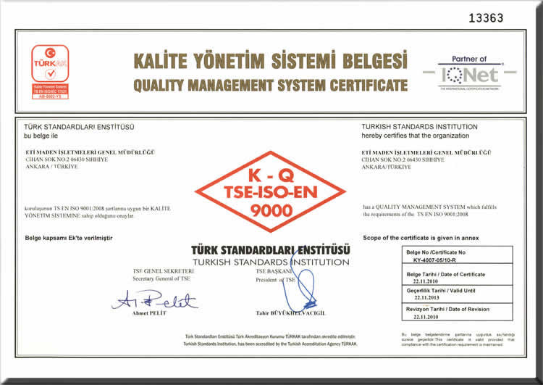
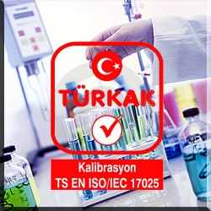
ETİ MADEN
Date of Establishment: 1935
1935 -1998 ETİBANK
1998 -2004 ETİ Holding A.Ş.
2004 -….. Eti Mine Works General Management
Main Field of Activity: The production and sales of boron products.
Legal Status: State owned company
Management Systems:
Integrated Management Systems
Quality Management System TS-EN-ISO 9001: 2008
Environmental Management System TS-ISO-EN-14000
Occupational Health & Safety Management System
TS-İSG-OHSAS 18001
General requirements for competence of test and calibration laboratories
TS-EN ISO/IEC 17025

Slide 30
Foreign Representatives & Sales Agents
Foreign Representatives
Sales Agencies
Etimine SA,
Luxembourg
AB Etiproducts O.Y.,
Finland
Etimine GmbH,
Germany
Etimine Srl,
Italy
Etimine USA,
USA
Etimine Asia,
China
Etiproducts Russia
Afro-Global Group PTY LTD.
Mario Pilato Blat S.A.,
Spain
Asian Agro Chemicals Corporation
Borochemie
Exclusive:
Luxembourg, Belgium, UK, Germany, France,
Ireland, Italy, Austria, Spain, Netherlands, Portugal,
Switzerland, Czech Republic, Slovak Republic,
Slovenia, Hungary, Croatia, USA, Canada,
Liechtenstein, Monaco, Gibraltar, San Marino, Andorra, Isle of Man, Channel Islands
Non-exclusive: Romania, Bulgaria, Serbia, China
Finland, Sweden, Norway, Denmark, Iceland, Estonia, Latvia, Lithuania, Russia, Poland, Belarus, Ukraine
Singapore, United Arab Emirates (UAE), Oman, India, Sri Lanka, Thailand, Indonesia, Hong Kong, Bangladesh, Burma, Malaysia, South China (Guangdong EFA.), Taiwan
South Africa, Ivory Coast, Ghana, Kenya, Zimbabwe, Nigeria, Benin, Uganda, Tanzania
India, Indonesia, Bangladesh, Sri Lanka, Thailand, Malaysia, United Arab Emirates (UAE)

Slide 31
Mission & Vision
MISSION
To utilize the national boron resources within the framework of sustainable development, and to serve these goods to all humanity by converting them into high quality value added boron products, thus to contribute to the nation’s prosperity.
VISION
To become an establishment which continues steady growth in traditional boron products market and takes a pioneering role in developing new boron products that make difference, and creates maximum added value from boron resources by making the country information and technology base of the world boron industry.

Slide 32
Contact
 | ADDRESS | TELEPHONE | E-MAIL | FAKS
ETİ MADEN , TURKEY | Ayvalı Mah. Halil Sezai Erkut Cad. Afra Sok. No:1/A 06100 Keçiören/ANKARA | 90 (312) 294 20 00 90 (312) 231 36 41 | webmaster@etimaden.gov.tr | 90 (312) 230 71 84
ETIMINE SA, LUXEMBOURG | 204, Zone Industrielle SCHELECK-II L-3225 Bettembourg LUXEMBOURG | +352 52 02 02 | BoronMail@etimine.com | +352-52 02 03
ETIMINE SRL, ITALY | Via Cassoli 4, 42100 Reggio Emilia, ITALY | + 39 (522) 45 19 67 | etiminesrl@libero.it | + 39 (522) 43 05 70
ETIMINE USA Inc, USA | Penn Center West Building 1 Suite 400 Pittsburgh, PA, 15276, USA | (1) 412-809 82 15 | etimineusa@etimine.usa.com | (1) 412 809 82 17
ETIMINE ASIA, CHINA | 325 Tianyaoqiao Rd. Gateway International Plaza, Room: 2510 P/C: 200030, Shanghai, CHINA | +86 21 336 324 13 | info@etimineasia.com | +86 21 336 325 12
AB ETI PRODUCTS O.Y. FINLAND | Piispanportti -9 02240 Espoo /FINLAND | +358-9-819 44 44 0 | sales@etiproducts.com | +358-9-819 44 44 4
BOROCHEMIE INTERNATIONAL PTE. LTD. | 77 High Street, #09-09 High Street Plaza, 179433, SINGAPORE | +65 6334 7500 | borochemie@singnet.co.sg | +65 6334 0735
AFRO-GLOBAL GROUP PTY. LTD. | 79 Oxford Road, Saxonwold 2196, Johannesburg, P.O.BOX 2381, Saxonwold 2132, SOUTH AFRICA | +26-11-486-1477 | Felicia@AfroGlobal.co.za | +26-11-486-3699
MARIO PILATO BLAT S.A., SPAIN | Paseo de Alameda 17, 46010 Valenciya, SPAIN | +34-96 339 32 70 | mpb@mariopilato.com | +34-96 369 08 50
ASIAN AGRO CHEMICALS CORPORATION | 11F-09 Amenity Centre Tower-2, Al-Jazeera Al Hamra, Ras Al Khaimah, U. A. E. | +971-7-2434822 | marketing@asiangro.ae | +971-7-2434823

